Slide 1
Sorting Algorithms
Lecture No 3
Insertion Sort
Quick sort

Slide 2
What is Insertion Sort?
Insertion sort arrange n elements of array by inserting particular item in a particular place in such a way that the item are in sorted order.

Slide 3
Sorted List
Unsorted list
N=6
5 | 4 | 10 | 1 | 6 | 2
temp
4
5 |  | 10 | 1 | 6 | 2
Free space
temp
4
Compare a[0]<a[temp]→condition is false so do shift the value of a[0] to free space and store the a[temp] value to a[0]
temp
4
4 | 5 | 10 | 1 | 6 | 2

Slide 4
Sorted List
Unsorted list
4 | 5 | 10 | 1 | 6 | 2
temp
4 | 5 |  | 1 | 6 | 2
temp
10
Do compare the temp value=10 to the list of unsorted array elements 5, 4. This loop should be decrement from right to left.
Is 5 >10→No ; 4>10→No;
4 | 5 | 10 | 1 | 6 | 2
Sorted List
Unsorted list

Slide 5
Sorted List
Unsorted list
4 | 5 | 10 | 1 | 6 | 2
temp
1
4 | 5 | 10 |  | 6 | 2
temp
1
Do compare the temp value to 10 if 1<10; condition True
4 | 5 | ? | 10 | 6 | 2
temp
1
Do compare the temp value to 5 if 1<5; condition True
4 | ? | 5 | 10 | 6 | 2
temp
1
Do compare the temp value to 4 if 1<4; condition True
1 | 4 | 5 | 10 | 6 | 2

Slide 6
Sorted List
Unsorted list
1 | 4 | 5 | 10 | 6 | 2
temp
6
1 | 4 | 5 | 10 |  | 2
If 10<6→False
temp
6
1 | 4 | 5 | ? | 10 | 2
temp
6
If 5<6→True; stop
1 | 4 | 5 | 6 | 10 | 2
Sorted List
Unsorted list

Slide 7
Sorted List
1 | 4 | 5 | 6 | 10 | 2
Unsorted list
temp
2
1 | 4 | 5 | 6 | 10
If 10<2; False
temp
2
1 | 4 | 5 | 6 | ? | 10
If 6<2; False
temp
2
1 | 4 | 5 | ? | 6 | 10
If 5<2; False
temp
2
1 | 4 | ? | 5 | 6 | 10
temp
2
If 4<2; False

Slide 8
1 | ? | 4 | 5 | 6 | 10
temp
2
If 1<2; True→Stop ; transfer the temp value
1 | 2 | 4 | 5 | 6 | 10
Sorted List

Slide 9
Sorted List
Unsorted list
n=6
5 | 4 | 10 | 1 | 6 | 2
a[2]
a[0]
a[1]
a[3]
a[4]
a[5]
We need two loops
increment
decrement
temp
4
for(i=1 ;i<n; i++)
{
temp=a[i];
j=i-1;
while(j>=0 && a[j]>temp)
{
a[j+1]=a[j];
// right value assign to the left value
j--;
}
a[j+1]=temp;
}
j=0 and a[0]>4
J=0 and 5>4
True
a[0+1]=a[0]
a[1]=a[0];
a[1]=5;
J=-1 False
a[-1+1]=4
a[0]=4

Slide 10
#include<iostream>
using namespace std;
// Function to sort an array using insertion sort
void insertionSort(int arr[], int n)
{
int i, temp, j;
for (i = 1; i < n; i++) {
temp= arr[i];
j = i - 1;
while (j >= 0 && arr[j] > temp) {
arr[j + 1] = arr[j];
j = j - 1;
}
arr[j + 1] = temp;
}
}

Slide 11
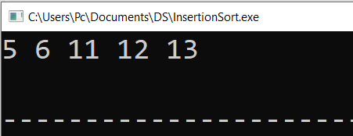
// A utility function to print an array
void printArray(int arr[], int n)
{
int i;
for (i = 0; i < n; i++)
cout << arr[i] << " ";
cout << endl;
}
// Driver code
int main()
{
int arr[] = { 12, 11, 13, 5, 6 };
int N = sizeof(arr) / sizeof(arr[0]);
insertionSort(arr, N);
printArray(arr, N);
return 0;
}
Output

Slide 12
Insertion Sort Algorithm
Step 1: Begin
Step 2: input a[n]
Step 3: set i←1
Step 4: Repeat step 5 to step 11 for(i<n;i++)
Step 5: Set temp←a[i]
Step 6: Set j←i-1;
Step 7: Repeat step 8 to step 9 while (j>=0 && a[j]>temp)
Step 8: Set a[j+1]←a[j]
Step 9: Set j←j-1;
Step 10 End While
Step 11: Set a[j+1]←temp
Step 12: End for
Step 13: Stop

Slide 13
Quick Sort

Slide 14
n=7
10 | 15 | 1 | 2 | 9 | 16 | 11
a[n]
a[0]
a[1]
a[2]
a[3]
a[4]
a[5]
a[6]
Select Pivot element: Assume 10 is the pivot element
This technique is based on divide and conquer rule
If the element is >10 then place those elements from the right side of the pivot element and vice versa
Values<Pivot element | Pivot Element | Values>Pivot element
Partition 1
Key
Partition 2

Slide 15
n=7
10 | 15 | 1 | 2 | 9 | 16 | 11
a[n]
a[0]
a[1]
a[2]
a[3]
a[4]
a[5]
a[6]
Select Pivot element: Assume 10 is the pivot element
fixed
2 | 1 | 9 | 10 | 15 | 11 | 16
Arrangement possibilities
1 ,2, 9
9,1,2
9,2,1
Arrangement possibilities
11,16,15
16,11,15
11,15,16

Slide 16
n=9
7 | 6 | 10 | 5 | 9 | 2 | 1 | 15 | 7
a[n]
a[0]
a[1]
a[2]
a[7]
a[3]
a[4]
a[5]
a[6]
a[8]
Select Pivot element: Assume 7 is the pivot element of a[0]
Start
7 | 6 | 10 | 5 | 9 | 2 | 1 | 15 | 7
If 7<=pivot element;
True;
7 | 6 | 10 | 5 | 9 | 2 | 1 | 15 | 7
end
If 6<=Pivot Element
True ;
Start
7 | 6 | 10 | 5 | 9 | 2 | 1 | 15 | 7
If 7>7 False ;
then do
swapping
7 | 6 | 10 | 5 | 9 | 2 | 1 | 15 | 7

Slide 17
Pivot Element =7
Start
End
7 | 6 | 7 | 5 | 9 | 2 | 1 | 15 | 10
If 7<=Pivot Element ; True
End
Start
7 | 6 | 7 | 5 | 9 | 2 | 1 | 15 | 10
If 5<=Pivot Element ; True
Start
End
7 | 6 | 7 | 5 | 9 | 2 | 1 | 15 | 10
If 9<=Pivot Element ; False ; Stop
Start
End
7 | 6 | 7 | 5 | 9 | 2 | 1 | 15 | 10
If 10>=Pivot Element ; True

Slide 18
Pivot Element =7
Start
End
7 | 6 | 7 | 5 | 9 | 2 | 1 | 15 | 10
Start
End
If 15>=Pivot Element ; True
7 | 6 | 7 | 5 | 9 | 2 | 1 | 15 | 10
If 1>=Pivot Element ; False
Then do swapping
Start
End
7 | 6 | 7 | 5 | 1 | 2 | 9 | 15 | 10
If 1<=Pivot Element ; True
Start
End
7 | 6 | 7 | 5 | 1 | 2 | 9 | 15 | 10
If 2<=Pivot Element ; True

Slide 19
Start
End
7 | 6 | 7 | 5 | 1 | 2 | 9 | 15 | 10
If 2<=Pivot Element ; True
End
Start
7 | 6 | 7 | 5 | 1 | 2 | 9 | 15 | 10
If 9<=Pivot Element ; False; Stop
Start
End
7 | 6 | 7 | 5 | 1 | 2 | 9 | 15 | 10
If 9>=Pivot Element ; True
End
Start
7 | 6 | 7 | 5 | 1 | 2 | 9 | 15 | 10
If 2>=Pivot Element ; False ;
Do not swapping in between start and stop because start crosses stop in position
7 | 6 | 7 | 5 | 1 | 2 | 9 | 15 | 10

Slide 20
Pivot Element =7
so we do swapping only with pivot element position
End
start
7 | 6 | 7 | 5 | 1 | 2 | 9 | 15 | 10
start
End
2 | 6 | 7 | 5 | 1 | 7 | 9 | 15 | 10
Pivot Element =2
Now again start procedure

Slide 21
n=9
lb
ub
7 | 6 | 10 | 5 | 9 | 2 | 1 | 15 | 7
a[n]
a[0]
a[1]
a[2]
a[7]
a[3]
a[4]
a[5]
a[6]
a[8]
Algorithm
Partition(a,lb,ub)
{
Pivot=a[lb];
Start=lb
End=ub
While (start<end){
While (a[start]<=Pivot)
{
Start++;
}
While (a[end]>Pivot)
{
End--; }
If start<end
{
swap a[start],a[end]
}
}
Swap (a[lb], a[end]); return end; }
QuickSort(a,lb,up)
{
If (lb<up)
{
loc=Partition(a,lb,ub)
QuickSort(a, lb, loc-1)
QuickSort(a,loc+1,ub)
}
}

Slide 22
Code
#include <iostream>
using namespace std;
// Function to swap two elements
void swap(int* a, int* b)
{
int t = *a;
*a = *b;
*b = t;
}

Slide 23
// Partition the array using the last element as the pivot
int partition(int arr[], int low, int high)
{
// Choosing the pivot
int pivot = arr[high];
// Index of smaller element and indicates
// the right position of pivot found so far
int i = (low - 1);
for (int j = low; j <= high - 1; j++) {
// If current element is smaller than the pivot
if (arr[j] < pivot) {
// Increment index of smaller element
i++;
swap(&arr[i], &arr[j]);
}
}
swap(&arr[i + 1], &arr[high]);
return (i + 1);
}

Slide 24
void quickSort(int arr[], int low, int high)
{
if (low < high) {
// pi is partitioning index, arr[p]
// is now at right place
int pi = partition(arr, low, high);
// Separately sort elements before
// partition and after partition
quickSort(arr, low, pi - 1);
quickSort(arr, pi + 1, high);
}
}

Slide 25
// Driver code
int main()
{
int arr[] = { 10, 7, 8, 9, 1, 5 };
int N = sizeof(arr) / sizeof(arr[0]);
// Function call
quickSort(arr, 0, N - 1);
cout<<"Sorted array:"<<endl;
for (int i = 0; i < N; i++)
cout<<arr[i]<<"\t";
return 0;
}

Slide 26
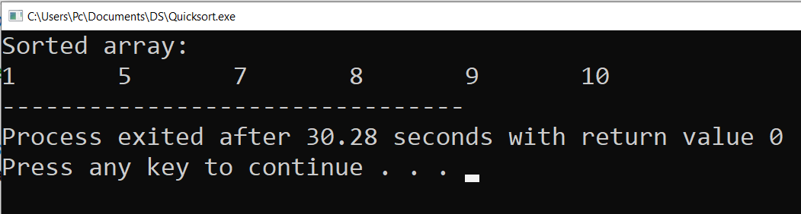
Output

